Slide 1
SensitiveMood Project Presentation
Group 19

Slide 2
Project Description
What we do: SensitiveMood is a mobile app that keeps track of your friends’ sentiment based on tweet data and detects device’s anomaly based on accelerometer data.
How we do it: We develop our anomaly detection (*sentiment and device movement) model using unsupervised machine learning algorithm and statistics. The entire architecture is microservices accomplished using serverless framework.

Slide 3
Architecture Solution
Inspired by the guest lecturer and impressed with its auto-scalability and lightweightness, we invest our time in learning how to build applications using serverless framework.
Microservices: we divide the entire backend system into 5 different microservices, UserService, TwitterService, SensorService, AlertService, and a powerful, machine learning based AnalyzeService.
Serverless Framework: AWS Lambda + AWS API Gateway + AWS RDS
Alert Functionality: AWS SNS

Slide 4
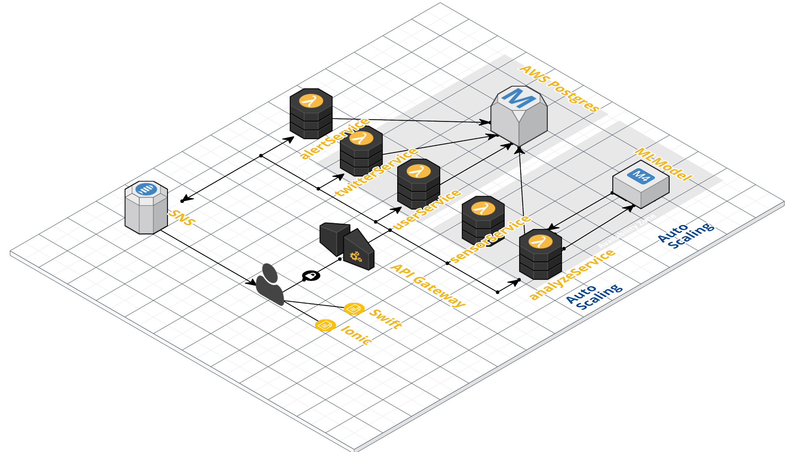
Architecture Diagram
Notes:
Architecture diagram

Slide 5
Modelling - How it works
Goal: set alert threshold by first profiling users through K-means clustering.
Alert logic: predict which cluster this user belongs to -> get associated threshold -> alert if the user’s next window behavior breaches the threshold

Slide 6
Modelling - K-means
Tweet-data based clustering model
Features: follower count, favorite count, friend count, status count, total activity count, averaged tweet sentiment score (context-window size =7 days)
2. Accelerometer-data based clustering model
Features: averaged X coordinates, averaged Y coordinates, averaged Z coordinates value, accumulative X coordinates changing value, accumulative Y coordinates changing value, accumulative Z coordinates changing value (context-window = 1 second)

Slide 7
Modelling - Tweet-data based model
Cluster ~1000 unique twitter users historical behavior
Found 2 clusters based on silhouette score.
Examine the cluster center to determine the characteristics of each cluster.
Smaller cluster has large activity, follower, friend, status count, but relatively negative sentiment score.
Calculate standard deviation of sentiment score and account activity and use that as the alert threshold.

Slide 8
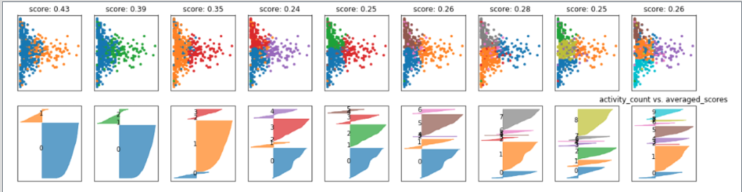
Modelling-Twitter Model-Silhouette Plot

Slide 9
Modelling - Accelerometer-data based model
Cluster ~10,000 second-level aggregated accelerometer features collected from 387 unique device.
Found 2 clusters based on silhouette score.
Examine the cluster center to determine the characteristics of each cluster.
Smaller cluster has large x,y,z absolute changes (more tilt, lift, twist movement)
Large cluster is relatively more stable
Calculate standard deviation of each feature and use that as the alert threshold.

Slide 10
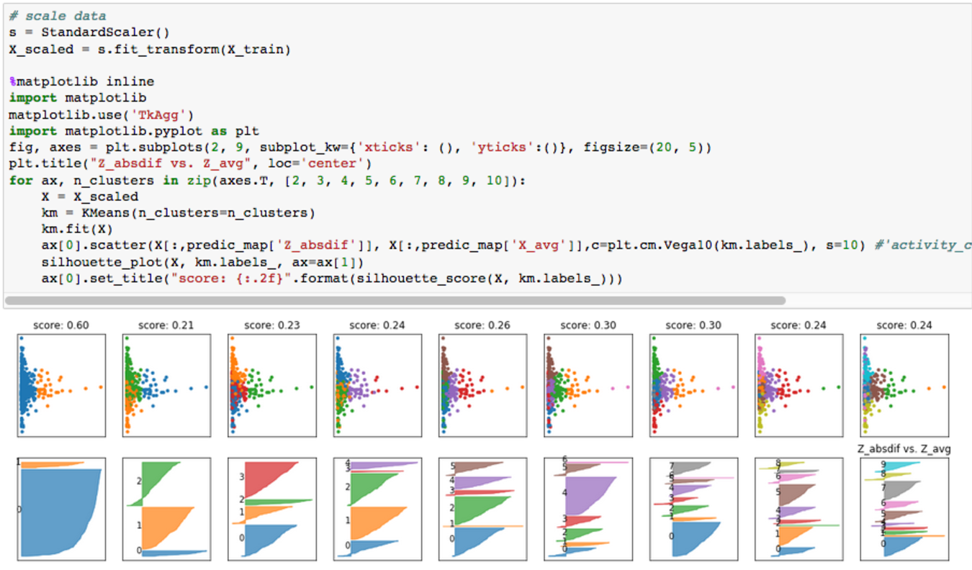
Modelling-Accelerometer Model -
Silhouette Plot

Slide 11
Alert Logic Summary:
Twitter Model
Step1. For each new user, wait till we have one-week (T1) worth of data, aggregate it and send feature values to the clustering model for profiling. Step2. Use the model prediction (cluster number) to set its alert threshold. Step3. At the end of second week (T2), we calculate the accumulated activities and averaged sentiment score in the past week, comparing against the threshold and send out alerts if apply. Step4. Redo Step1-2-3 (use the current T2’s aggregated features to reprofile user, and get updated threshold, and apply T3’s sentiment and activity score to send alert)
2. Accelerometer Model
Step1: get aggregated second level accelerometer data for each device, send them through the model to profile the behavior. Get the alert threshold based on predicted cluster number. Step2: schedule a job to get new accelerometer data of a later context window, if upon re-clustering, the new cluster number changed from cluster 0 to cluster 1, then we alert the user that the device of interest is undergoing drastic movement; if upon sampling, the newly aggregated accelerometer data breaches the stored threshold, we alert the user of the device’s abnormal behavior as well.

Slide 12
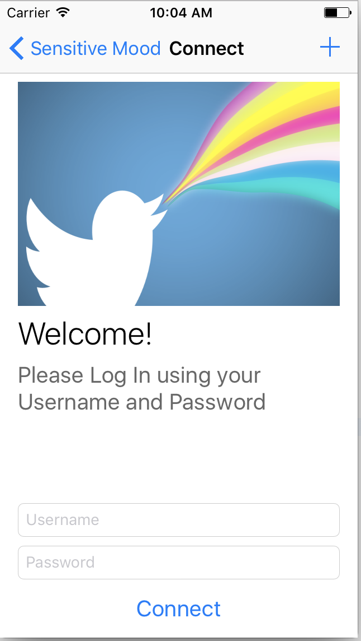
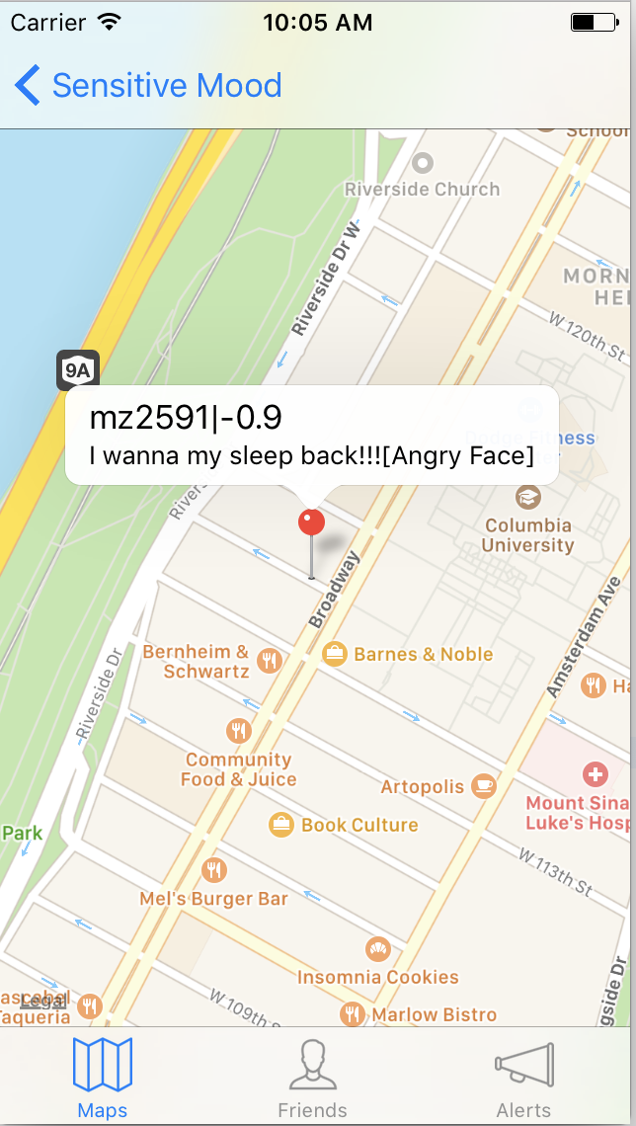
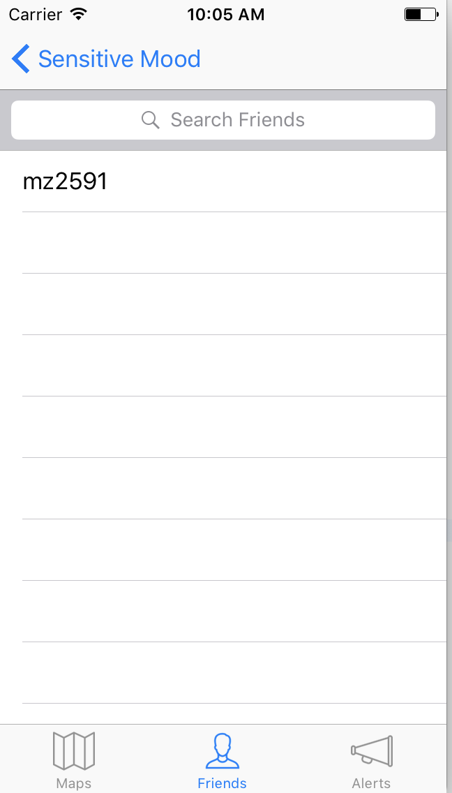
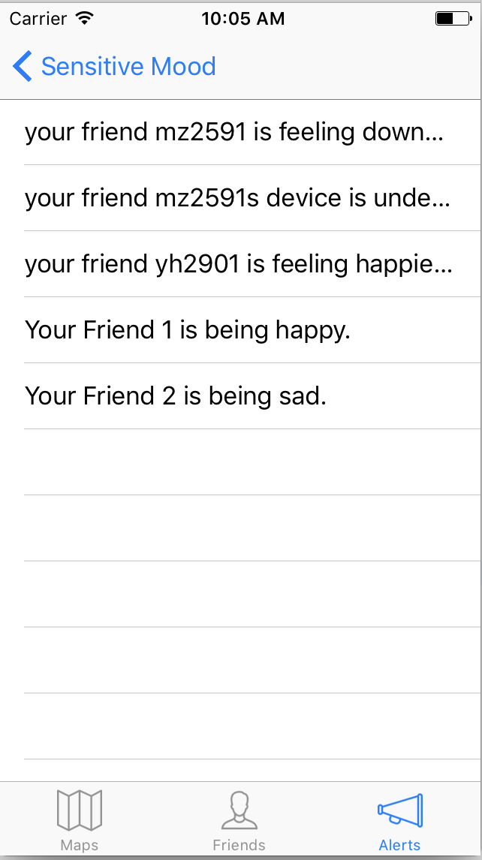
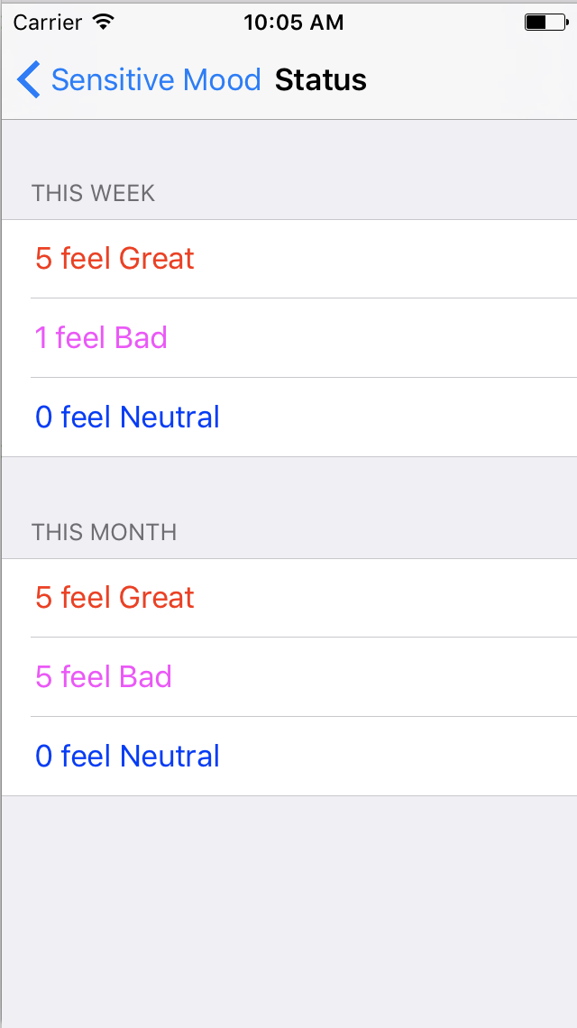
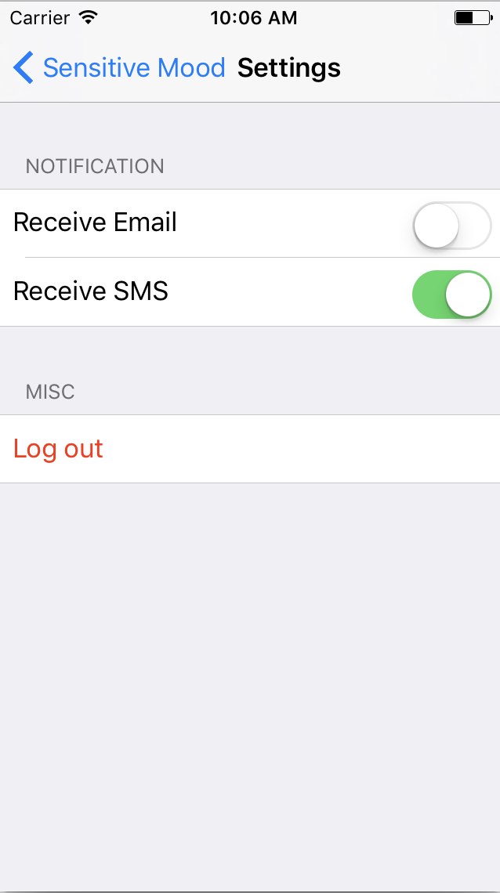
Screen Shots

Slide 13
Demo
Eye beholds ~

Slide 14
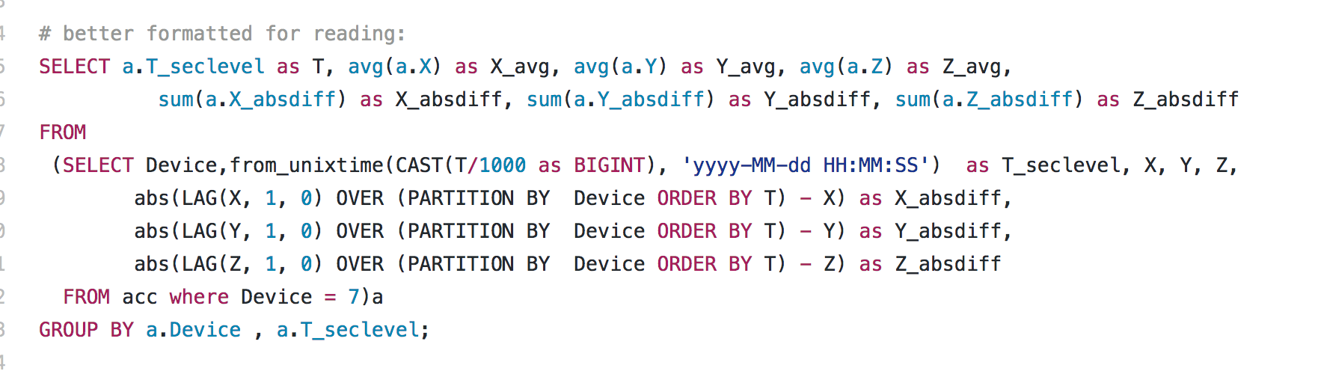
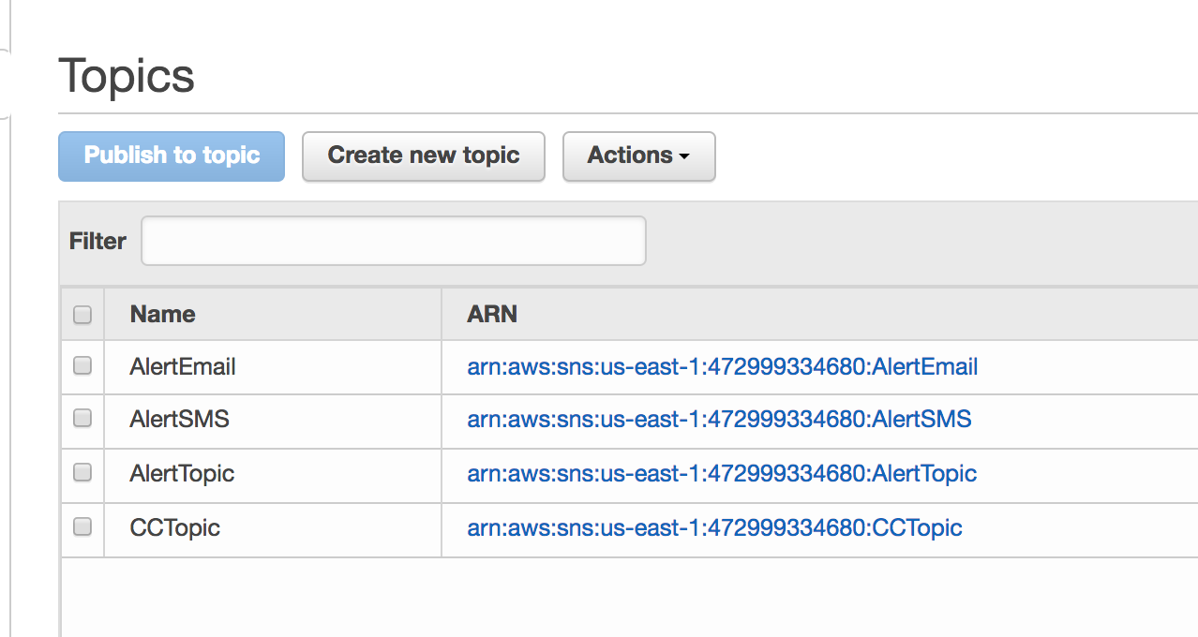
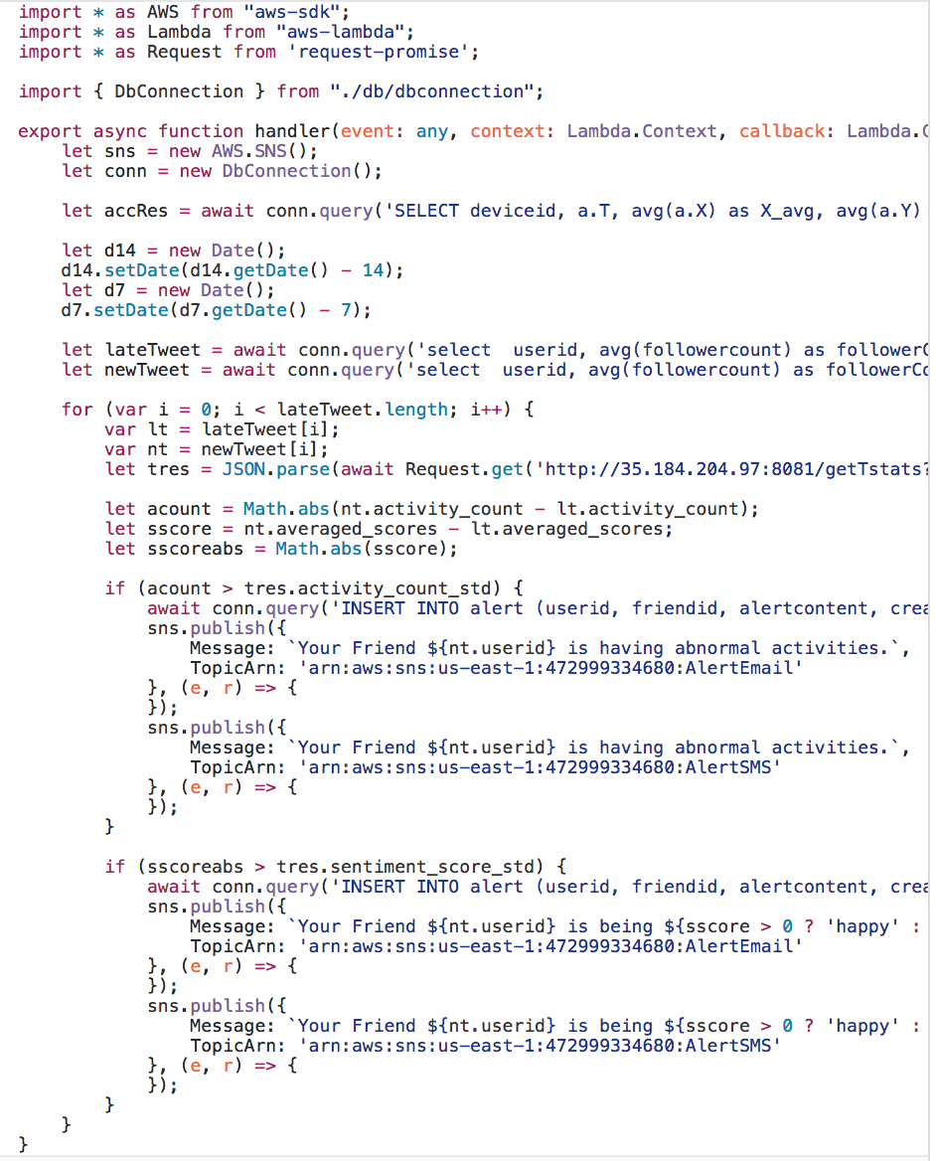
Code Flow
sql
SNS topic for Alerts
model
Alertservice

Slide 15
Thank You!

